Slide 1
Activity Diagrams
OOAD Lecture Week 4

Slide 2
In this lecture
We will:
Introduce UML diagram
Activity diagram
Notations of activity diagram
Practice to draw activity diagram

Slide 3
The use of UML
We shall develop the following diagrams in the order given
Use case diagram
One for the entire application
Activity diagrams
One per use case
Use case diagram
One for the entire application
Activity diagrams
One per use case
Describe the problem domain
Class diagram
One for the entire application
Sequence diagrams
One per use case
Class diagram
One for the entire application
Sequence diagrams
One per use case
Describe the solution domain

Slide 4
Activity diagrams
An activity diagram describes the workflow of a single use case
An activity diagram focuses on:
The actions performed when the use case is executed
The order in which those activities are done
Hint
When identifying the actions, assume they are done without a computer
This will keep you in the problem domain

Slide 5
Activity diagrams
An activity diagram has:
Action nodes
Control nodes
An activity has one or more action nodes
An action node has exactly one flow in and one flow out
Control nodes can be:
Activity initial and activity final
Decision and merge

Slide 6
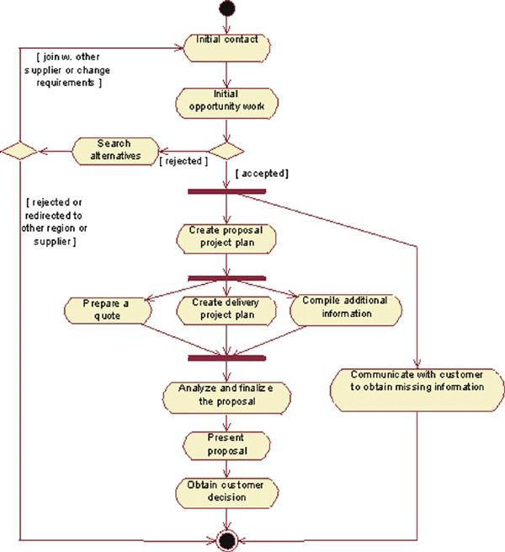
Example 1
This example is a proposal
process, taken from an
organization that sells telecom
network solutions.

Slide 7
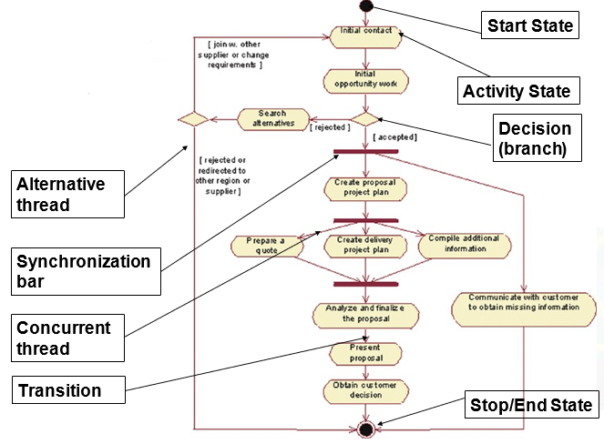
Basic Notations

Slide 8


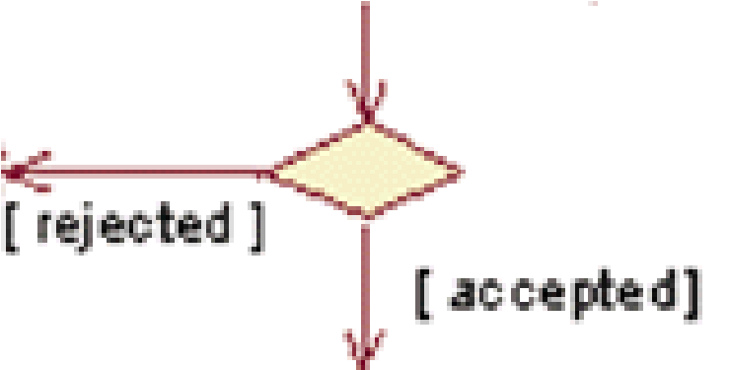


Basic Notations
Activity states, represent the performance of a step within the workflow.
Transition show what activity state follows another.
Decisions (branch) for which a set of guard conditions are defined. These are conditions that must be met to trigger the transition.
Synchronization bars, which you can use to show parallel sub flows. They allow to show concurrent threads - fork or join.

Slide 9
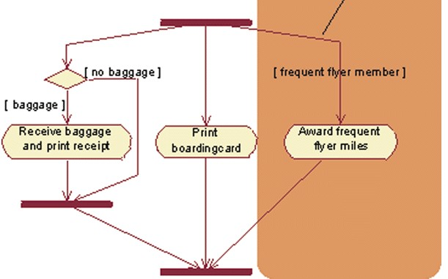
Advanced Notations
Guard conditions can be used to show that one of a set of concurrent threads is conditional.

Slide 10
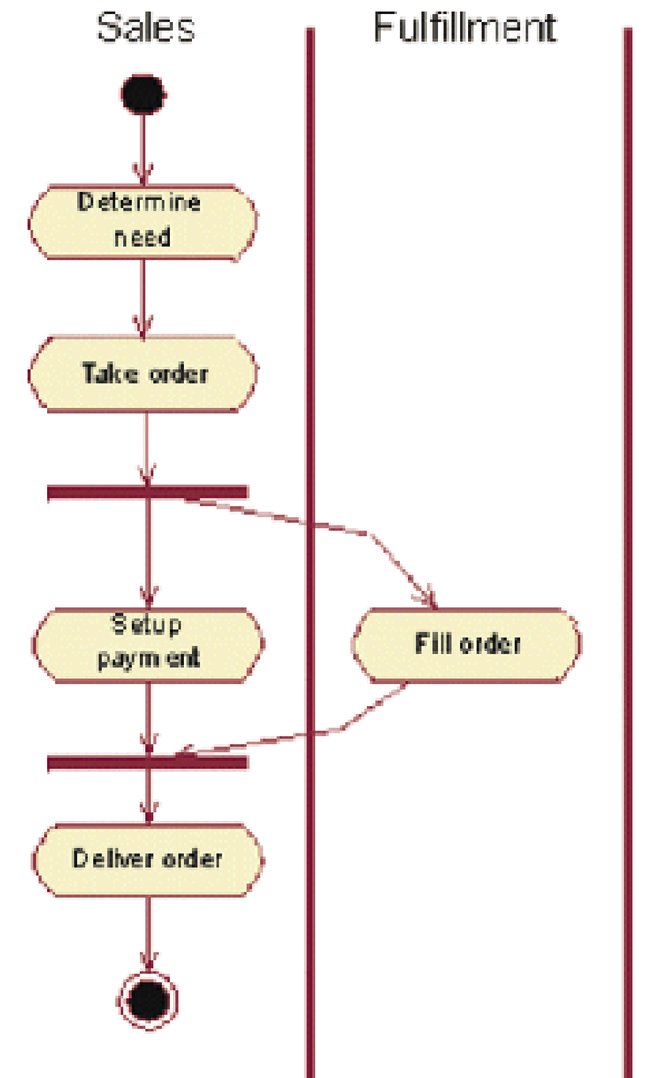
Advanced Notations Partitions
The contents of an activity diagram may be organized into partitions (swimlanes) using solid vertical lines.
A partition does not have a formal semantic interpretation, but is, in business modeling, often used to represent an organizational unit of some kind.

Slide 11
Summary
Business modelling is typically done before system modelling.
Fork: One incoming transition and two or more outgoing transition.
Join: Two or more incoming transition and one outgoing transition.
Synchronization bar allow sequential threads.
Conditional threads are also called triggered transitions and must be shown with a guard condition.
Transitions without guard conditions are called triggerless transitions.

Slide 12
Now You should be able to…
Describe and use the following UML diagrams
Use case diagrams
Activity diagrams
In the next lecture we will:
Introduce the diagrams for solution domain
Class diagram
Sequence diagrams

Slide 13
References
Booch, G.; Maksimichuk, R.A.; Engle, M.W.; Young, B.J.; Conallen, J.; Houston, K.A. (2011) Object-oriented analysis and design with applications. Addison-Wesley

